Slide 1
Visualization and Practice in Deep Learning

Slide 2
About This Course
This course is about:
Basic theories and concepts of visualization
Applications of visualization in machine learning, especially in deep learning
Practices of MindInsight visualization tool and MindSpore deep learning framework

Slide 3
Objectives
Upon completing this course, you should be able to:
Understand the main principles of visualization.
Understand the value of visualization in the development of machine learning and deep learning.
Use MindSpore and MindInsight to perform simple visualization operations.

Slide 4
Contents
Overview of Visualization
Exploration in Visualization
Practice of MindSpore and MindInsight

Slide 5
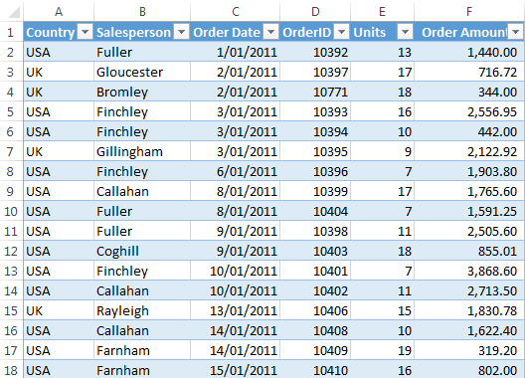
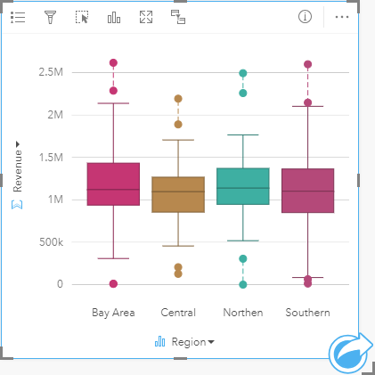
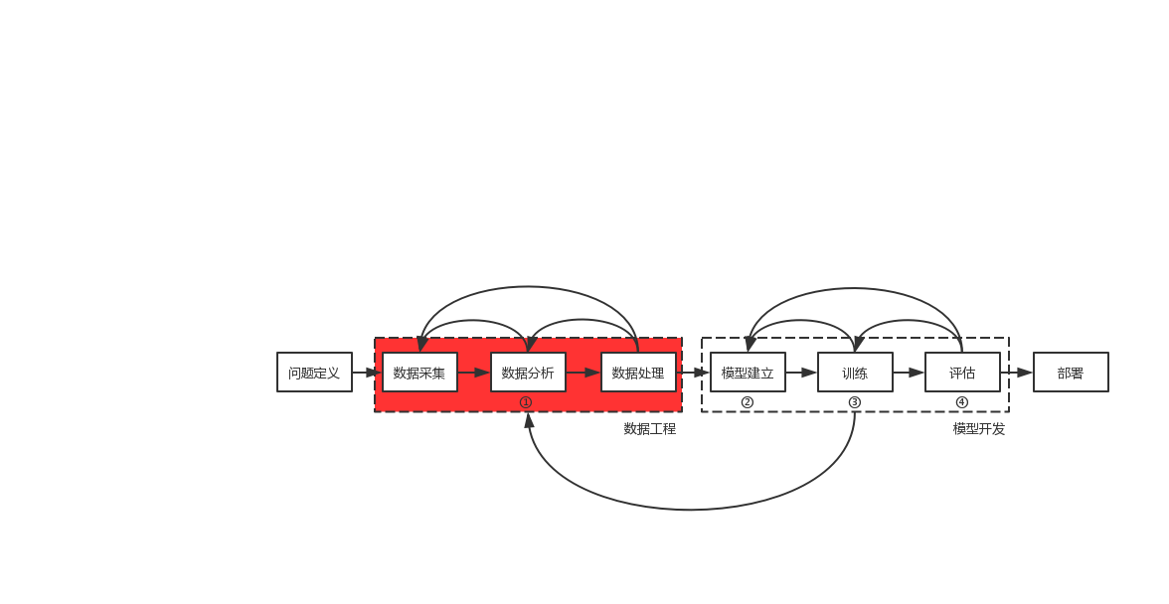
1. Overview of Visualization (1)
Definition
Visualization is a graphical representation of data.
Role in the machine learning process
Mapped to
[1]
[2]
Define a problem
Collect data
Analyze data
Process data
Build a model
Train
Evaluate
Deploy
Data engineering
Model development
Data
Visualization
Training Visualization
https://doc.arcgis.com/zh-cn/insights/create/box-plot.htm
https://www.myonlinetraininghub.com/excel-tabular-data-format

Slide 6
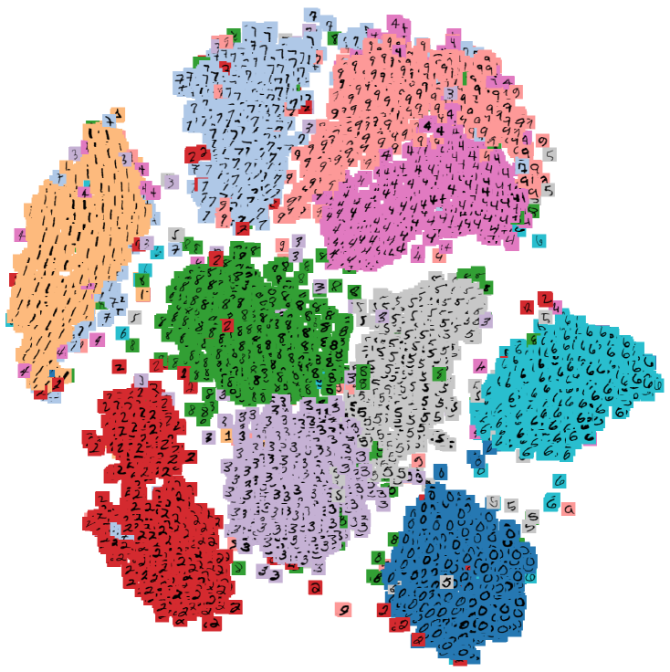

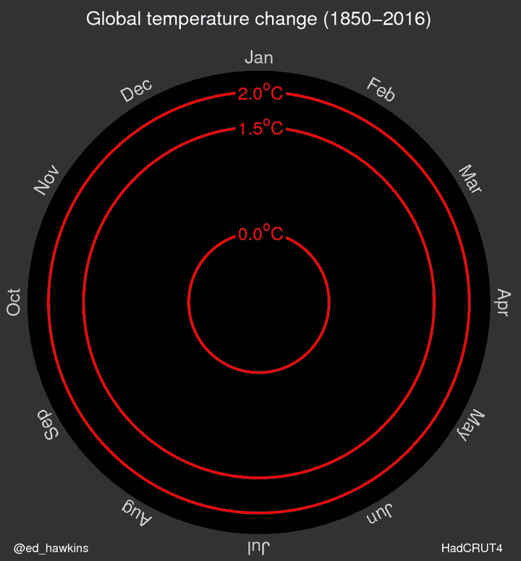
1. Overview of Visualization (2)
MNIST handwritten digit recognition
Global temperature change
Dimensionality reduction
t-SNE
[3]
[4]
Data dimensions include monthly temperature, month, and year, which can be visually displayed in a two-dimensional spiral graph.
[5]
https://en.wikipedia.org/wiki/MNIST_database
MING YAO. A SURVEY ON VISUALIZATION FOR EXPLAINABLE CLASSIFIERS[J]. 2017.
Mooney, Chris (11 May 2016). "This scientist just changed how we think about climate change with one GIF"

Slide 7

Contents
2. Exploration in Visualization
2.1 Data Statistics and Analysis
2.2 Dimensionality Reduction of High-Dimensional Data
2.3 Data Diagnosis
2.4 Visualization in deep learning(Computational Graph)
2.5 Visualization in deep learning(Model Training)
2.6 Visualization in deep learning(Model Evaluation)
2.7 Visualization in deep learning(Model Explanation)

Slide 8
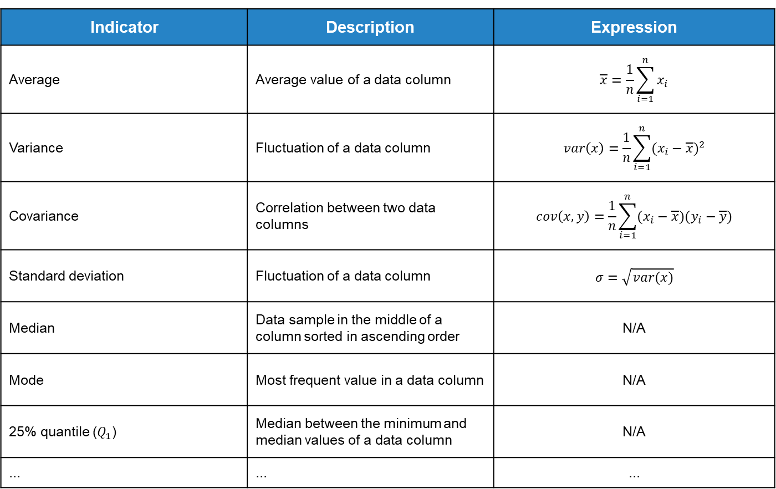
2.1 Data Statistics and Analysis (1)
Statistical indicators for tabular data
Indicator | Description | Expression
Average | Average value of a data column | $$\overline{x}=\frac{1}{n}\sum_{i=1}^{n}{x_{i}}$$
Variance | Fluctuation of a data column | $$var\left(x\right)=\frac{1}{n}\sum_{i=1}^{n}{{(x_{i}−\overline{x})}^{2}}$$
Covariance | Correlation between two data columns | $$cov\left(x,y\right)=\frac{1}{n}\sum_{i=1}^{n}{(x_{i}−\overline{x})(y_{i}−\overline{y})}$$
Standard deviation | Fluctuation of a data column | $$σ=\sqrt{var(x)}$$
Median | Data sample in the middle of a column sorted in ascending order | N/A
Mode | Most frequent value in a data column | N/A
25% quantile ($Q_{1}$) | Median between the minimum and median values of a data column | N/A
... | ... | ...

Slide 9



2.1 Data Statistics and Analysis (2)
Statistical indicators for non-tabular data
Data Type | Indicator | Description
Text | Word frequency statistics | Counts the occurrences of each word.
Image | Pixel color statistics | Discretizes the pixel range into several segments and calculates the proportion of each segment.
Audio | Audio frequency statistics | Discretizes the sound frequency range into several segments, calculates the proportion of each segment, and visualizes the result.

Slide 10
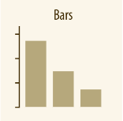
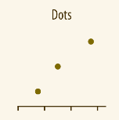
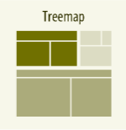
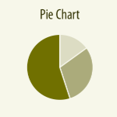
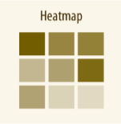
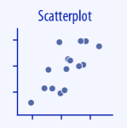
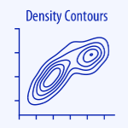
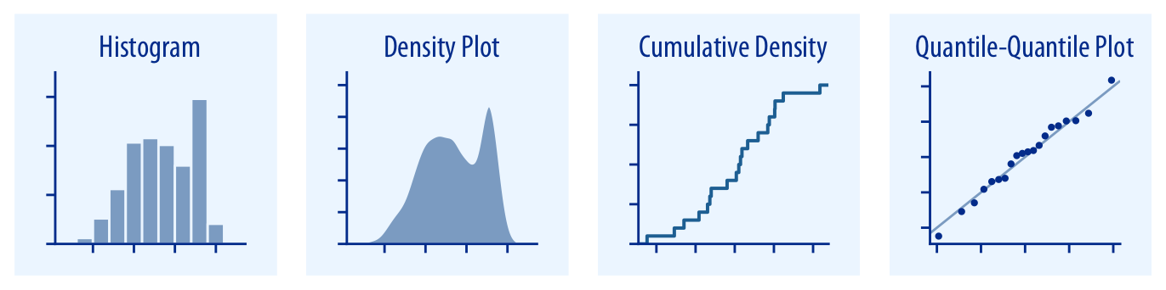
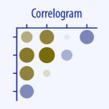
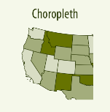
2.1 Data Statistics and Analysis (3)
Statistics and analysis: charts
Type | Charts
Quantity
Distribution
Type | Charts
Proportion
X-Y axis
Geospatial data

Slide 11
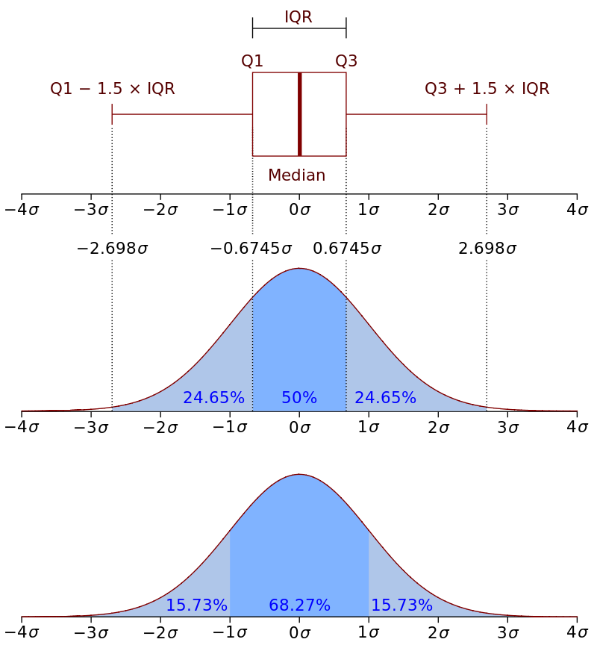
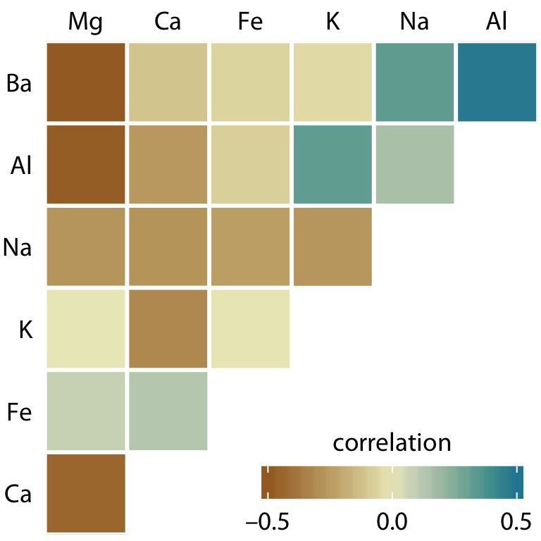
2.1 Data Statistics and Analysis (4)
Statistics and analysis: box plot
Box plots contain most basic statistical indicators. Generally, they contain a median, 25% quantile, and 75% quantile.
The figure on the right compares a normal distribution curve with its corresponding box plot.
Statistics and analysis: covariance heatmap
Compared with statistics on a single data column, measuring the correlation between any two data columns can provide more insights.

Slide 12
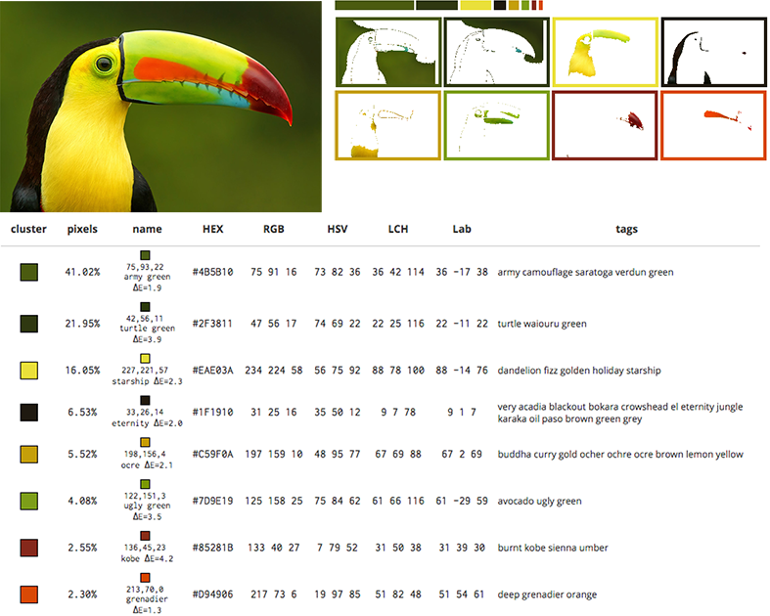
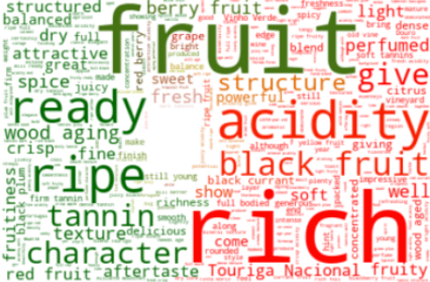
2.1 Data Statistics and Analysis (5)
Statistics and analysis: non-tabular data chart
[6]
[7]
This is a word cloud based on text data. A larger font size indicates a higher frequency of occurrences.
The pixel ratio of an image can be calculated through discrete pixel intervals or pixel clustering.
https://www.datacamp.com/community/tutorials/wordcloud-python
http://mkweb.bcgsc.ca/color-summarizer/?

Slide 13
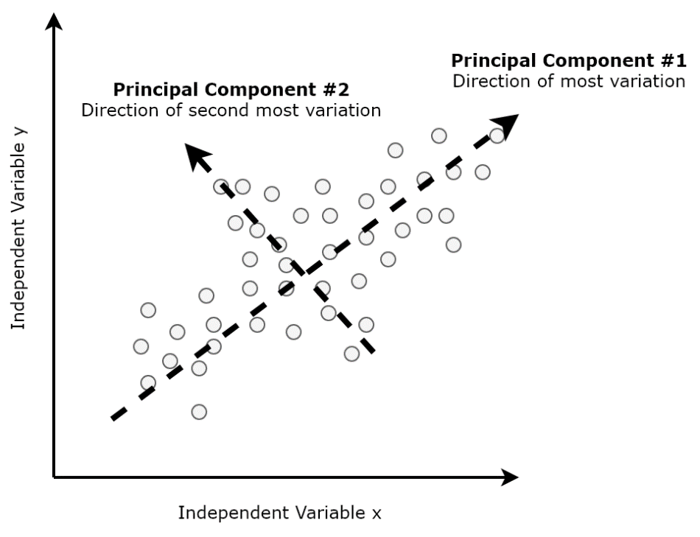
2.2 Dimensionality Reduction of High-Dimensional Data (1)
Dimensionality reduction of high-dimensional data
Many data samples are in a form of a high-dimensional vector and cannot be visualized in a two- or three-dimensional image. Therefore, dimensionality reduction is imperative to visualization.
Principal component analysis (PCA)
PCA uses orthogonal transformation to discover directions that are mutually perpendicular, and it can retain data fluctuation to the maximum extent. Subsequently, through linear transformation, the original dataset can be reduced to the target dimensions.
Standardize the original dataset $X_{m×n}$ by averaging out columns.
Standardize the original dataset 𝑿_(𝒎×𝒏) by averaging out columns.
Compute a covariance matrix $C_{n×n}$.
Compute a covariance matrix 𝑪_(𝒏×𝒏).
Compute n eigenvalues and the corresponding eigenvectors.
Sort eigenvalues in descending order and select the top k eigenvalues.
Construct a transformation matrix $C_{n×k}^{′}$ with k eigenvectors.
Construct a transformation matrix 𝑪_(𝒏×𝒌)^′ with k eigenvectors.
Obtain a new dimension-reduced dataset $X_{n×k}^{′}=XC^{′}$.
Obtain a new dimension-reduced dataset 𝑿_(𝒏×𝒌)^′=𝑿𝑪^′.
Variable y
Variable x
[8]
https://hackernoon.com/principal-component-analysis-unsupervised-learning-model-8f18c7683262

Slide 14
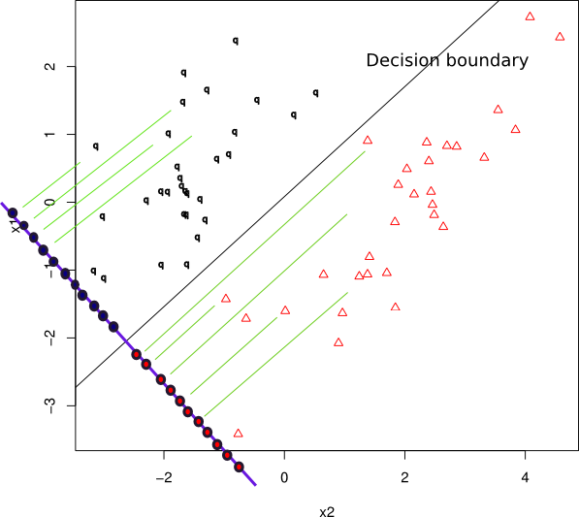
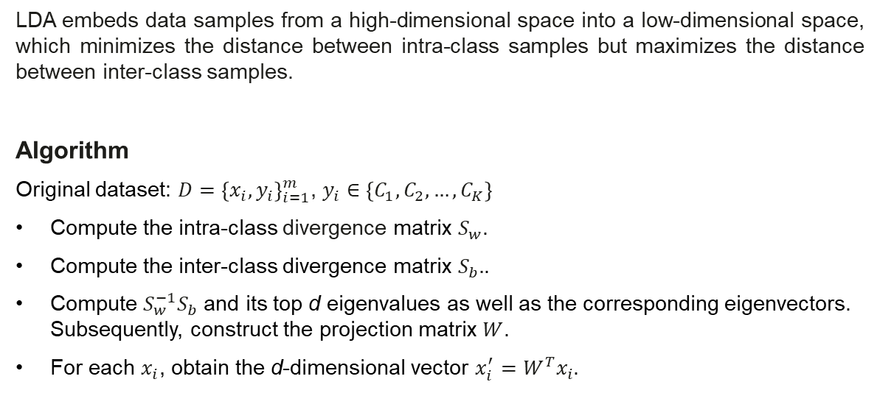
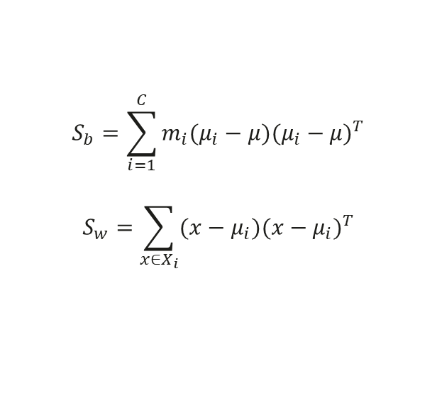
2.2 Dimensionality Reduction of High-Dimensional Data (2)
Linear discriminant analysis (LDA)
In addition to PCA, LDA is also a linear dimensionality reduction method that has two distinct characteristics.
LDA assumes that the original dataset obeys multidimensional normal distribution.
LDA depends on the class label and is a supervised method. PCA, by contrast, is an unsupervised method.
LDA embeds data samples from a high-dimensional space into a low-dimensional space, which minimizes the distance between intra-class samples but maximizes the distance between inter-class samples.
Algorithm
Original dataset: $D={\left\{x_{i},y_{i}\right\}}_{i=1}^{m}$, $y_{i}∈\left\{C_{1}, C_{2}, …, C_{K}\right\}$
Compute the intra-class divergence matrix $S_{w}$.
Compute the inter-class divergence matrix $S_{b}.$.
Compute $S_{w}^{−1}S_{b}$ and its top d eigenvalues as well as the corresponding eigenvectors. Subsequently, construct the projection matrix $W$.
For each $x_{i}$, obtain the d-dimensional vector $x_{i}^{′}=W^{T}x_{i}$.
[9]
$$S_{b}=\sum_{i=1}^{C}{m_{i}(μ_{i}−μ){(μ_{i}−μ)}^{T}}$$
$$S_{w}=\sum_{x∈X_{i}}{({x−μ}_{i}){({x−μ}_{i})}^{T}}$$
https://stats.stackexchange.com/questions/111421/reproduce-linear-discriminant-analysis-projection-plot

Slide 15
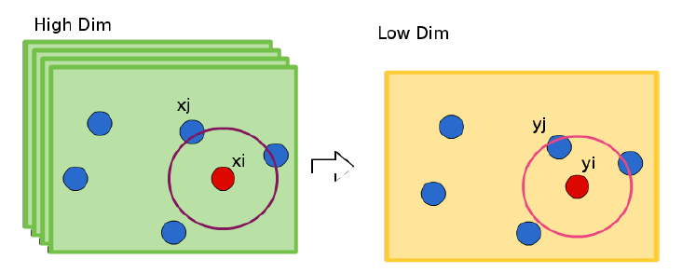
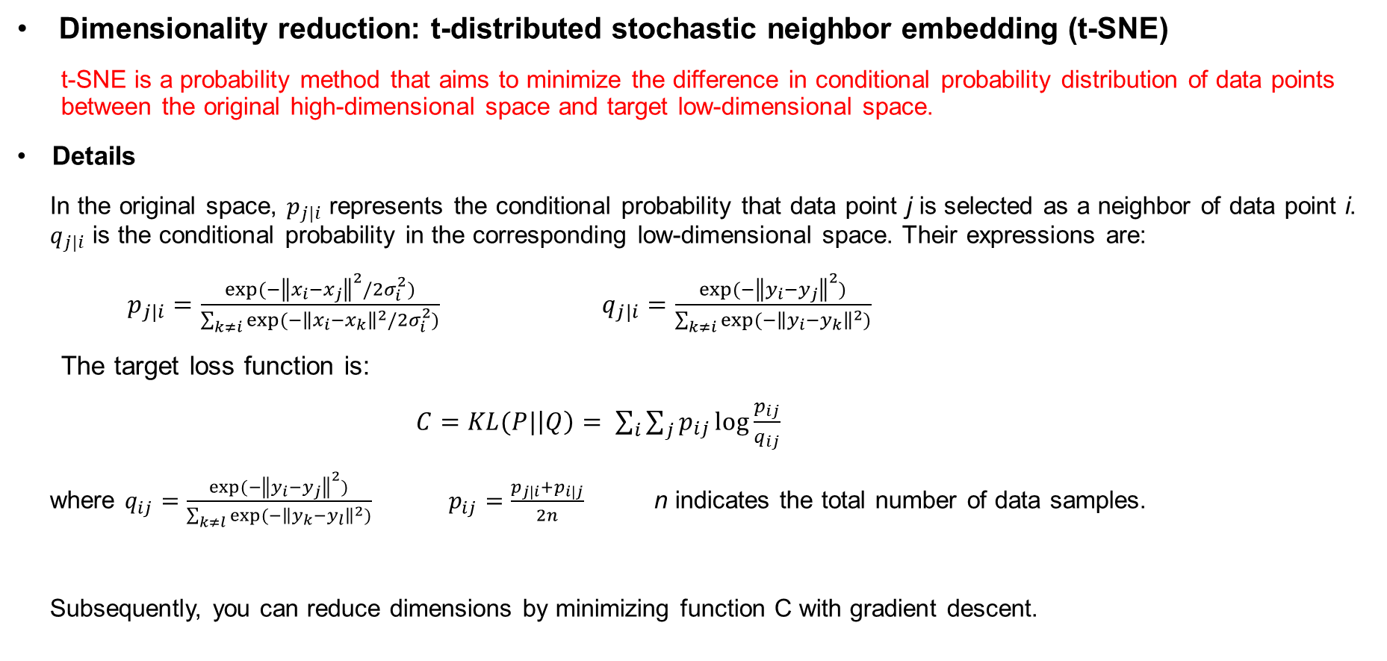
2.2 Dimensionality Reduction of High-Dimensional Data (3)
Dimensionality reduction: t-distributed stochastic neighbor embedding (t-SNE)
t-SNE is a probability method that aims to minimize the difference in conditional probability distribution of data points between the original high-dimensional space and target low-dimensional space.
Details
In the original space, $p_{j|i}$ represents the conditional probability that data point j is selected as a neighbor of data point i. $q_{j|i}$ is the conditional probability in the corresponding low-dimensional space. Their expressions are:
$p_{j|i}=\frac{exp⁡(−{\left\|x_{i}−x_{j}\right\|}^{2}/2σ_{i}^{2})}{\sum_{k≠i}{exp⁡(−{\left\|x_{i}−x_{k}\right\|}^{2}/2σ_{i}^{2})}}$ $q_{j|i}=\frac{exp⁡(−{\left\|y_{i}−y_{j}\right\|}^{2})}{\sum_{k≠i}{exp⁡(−{\left\|y_{i}−y_{k}\right\|}^{2})}}$
The target loss function is:
$C=KL(P|\left|Q\right)= \sum_{i}{\sum_{j}{p_{ij}\log{\frac{p_{ij}}{q_{ij}}}}}$
where $q_{ij}=\frac{exp⁡(−{\left\|y_{i}−y_{j}\right\|}^{2})}{\sum_{k≠l}{exp⁡(−{\left\|y_{k}−y_{l}\right\|}^{2})}}$ $p_{ij}=\frac{p_{j|i}+p_{i|j}}{2n}$ n indicates the total number of data samples.
Subsequently, you can reduce dimensions by minimizing function C with gradient descent.
High-dimensional
Low-dimensional

Slide 16
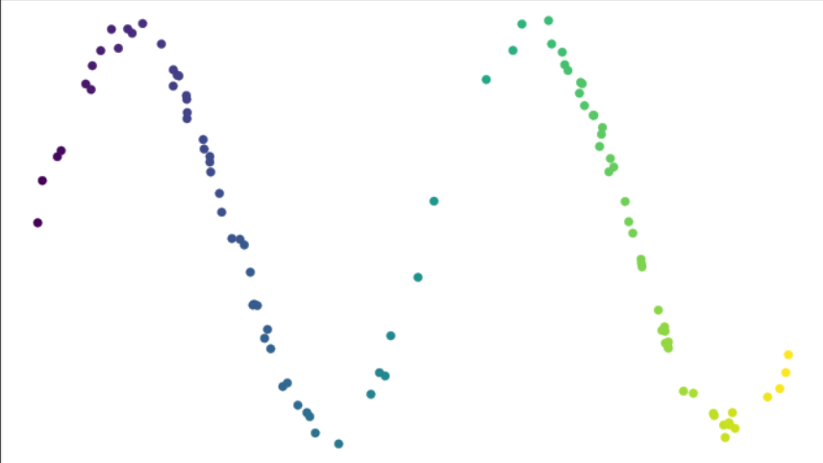
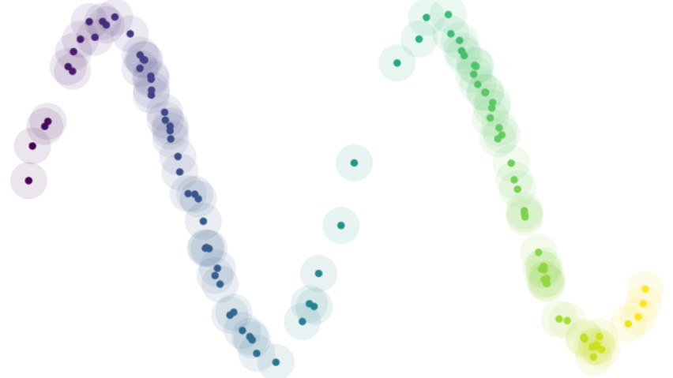
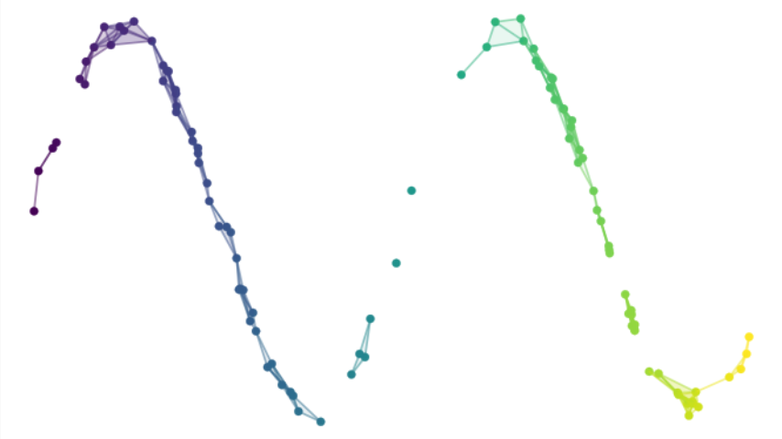
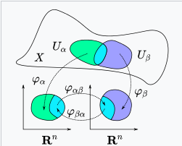
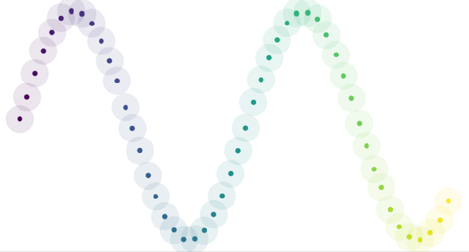
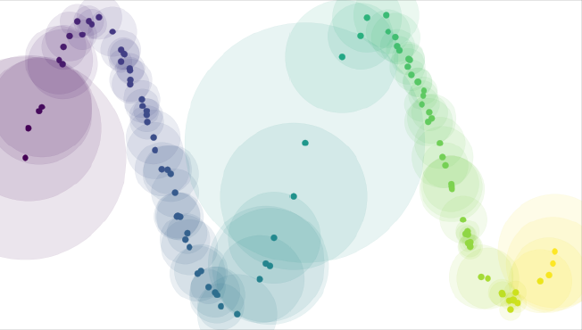
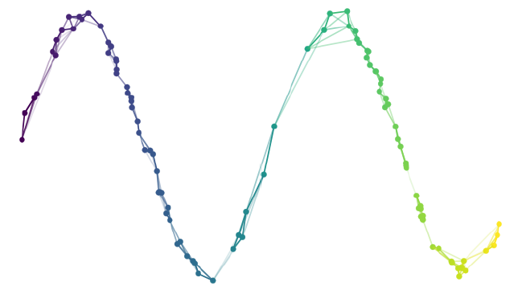

2.2 Dimensionality Reduction of High-Dimensional Data (4)
Uniform manifold approximation and projection (UMAP)
Principles:
Construct a fuzzy topological representation of high-dimensional data.
Iteratively optimize cross entropy to construct an equivalent topological representation in a low-dimensional space.
Hypothesis:
Data is uniformly distributed on the Riemannian manifold. However, in practice, real world data rarely behaves so nicely. Therefore, design an appropriate Riemannian metric to make the hypothesis true.
The Riemannian metric is a local constant.
The manifold is partially connected.
Topological space X
Data is not uniformly distributed on the manifold, resulting in poor coverage.
Mapping from topological to Euclidean space
Transfer mapping
In ideal situations, data is uniformly distributed on the manifold.
Construct a Riemannian metric to uniformly distribute data on the manifold.

Slide 17
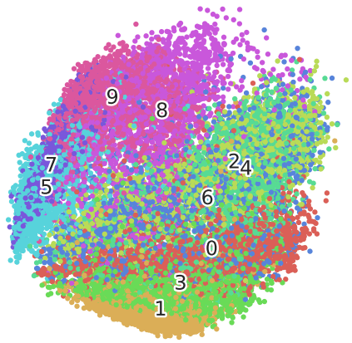
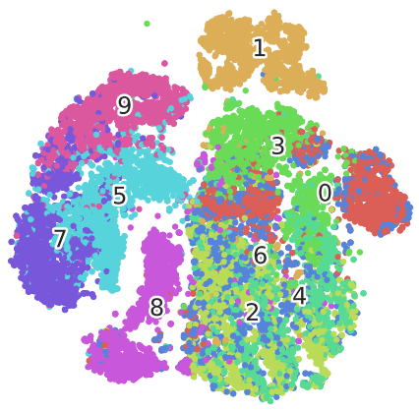
2.2 Dimensionality Reduction of High-Dimensional Data (5)
Comparison and summary of methods
Method | Linear | Speed | Supervised | Uncertainty Involved
PCA | Yes | Fast | No | No
LDA | Yes | Fast | Yes | No
t-SNE | No | Slow | No | Yes
UMAP | No | Moderate | No | Yes
It is clearly evident that the dimensionality reduction effect of t-SNE is better than that of PCA on the MNIST dataset.
PCA MNIST
T-SNE MNIST

Slide 18
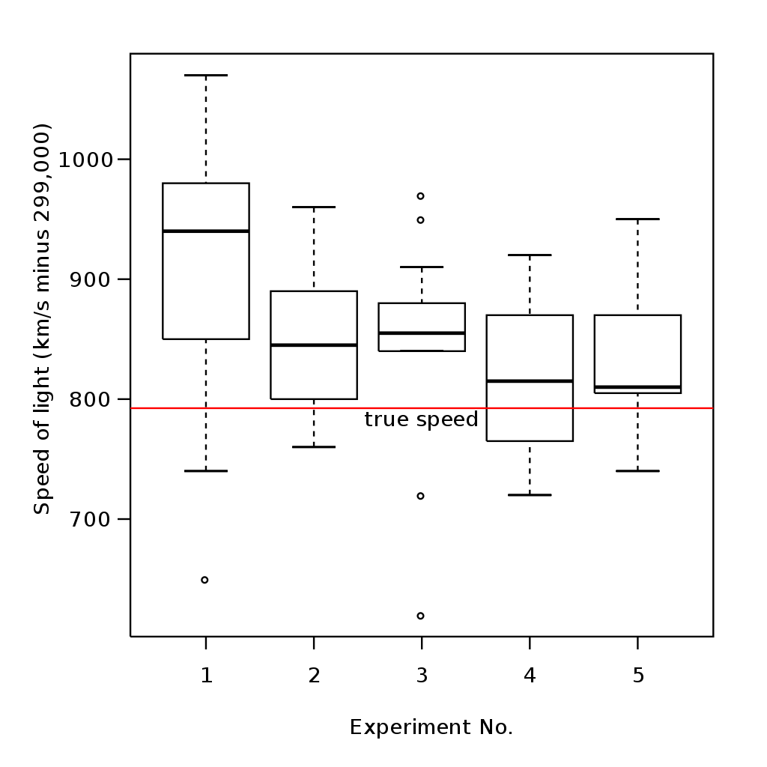
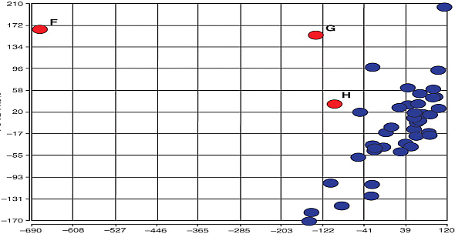
2.3 Data Diagnosis (1)
Outlier detection
Definition: In statistics, an outlier is a data point that significantly differs from other observations.
Outlier
[10]
[11]
[4]
In this scatter chart, two data points (labeled F and G) are outliers, and the data point labeled H is just a suspected outlier.
Source: Michelson-Morley experiment
Some images are in incorrect clusters.
https://apandre.wordpress.com/visible-data/outliers/
https://en.wikipedia.org/wiki/Outlier

Slide 19
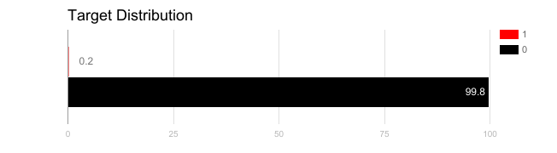
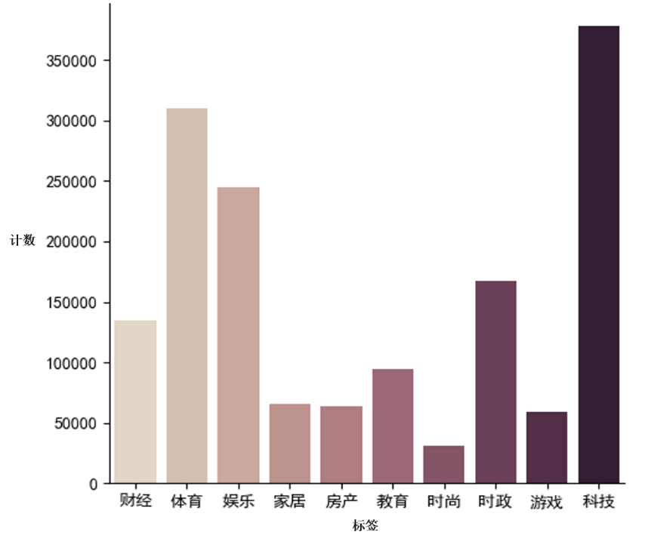
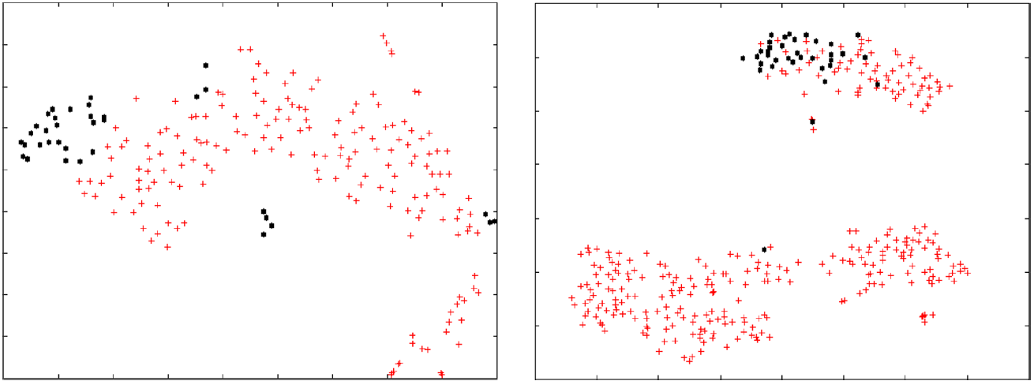
2.3 Data Diagnosis (2)
Class imbalance
Description: In a dataset, some classes account for a very small proportion, which may lead to inaccurate judgment.
Assume that the figure on the right is the distribution of a cancer diagnosis dataset. If we predict that all the data samples are not cancer ("0"), we can directly attain an accuracy of 99.8%.
[12]
Count
Finance Sports ENT Home Property Edu Fashion Politics Game Tech
Class imbalance detection through dimensionality reduction (t-SNE)
Histogram - statistics on the classes in a news dataset
https://www.datacamp.com/community/tutorials/diving-deep-imbalanced-data

Slide 20
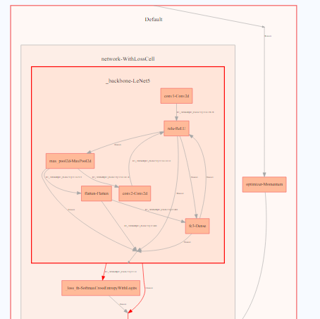
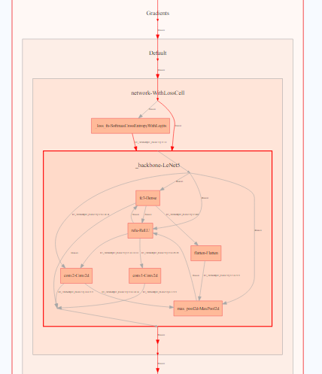
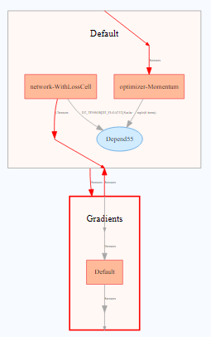
2.4 Visualization in deep learning(Computational Graph)
Machine learning models, especially deep learning models, can be generally presented using a two-dimensional diagram, where each point represents an operation, and each line represents a data/control flow. The following is an example of a simple convolutional neural network (Lenet5).
Combine them with loss and optimizer
Forward nested structure
Backward nested structure

Slide 21
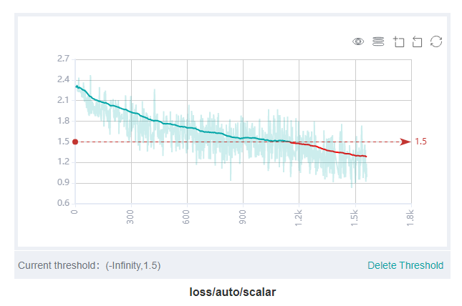
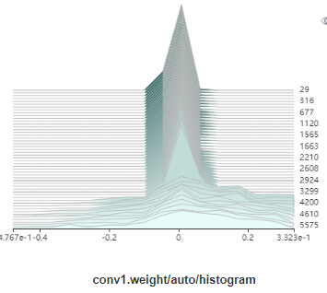
2.5 Visualization in deep learning(Model Training)
Changes of training indicators (such as discrepancy and accuracy) and model parameters during training:
Training diagnosis: Did the loss converge? Or out of control?...
Education: Deepen the understanding of the training process.
Time step
Distribution
Scalar plot for loss or accuracy
Histogram for layer weights

Slide 22
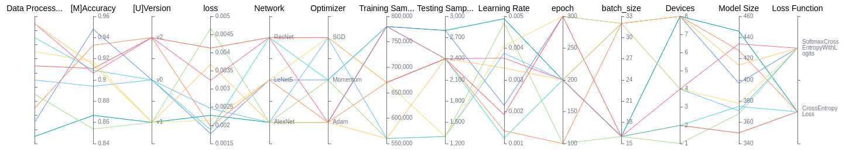
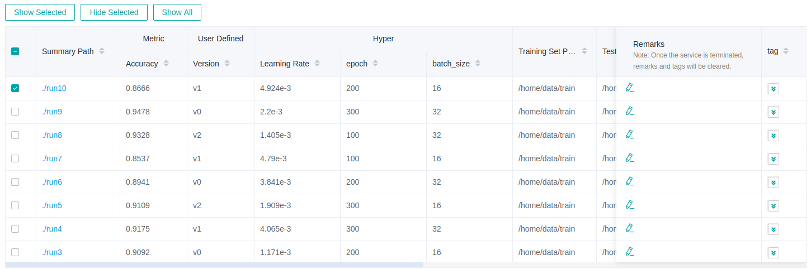
2.6 Visualization in deep learning(Model Evaluation)
Evaluation indicators after training
Model diagnosis: Did any overfitting occur? Or any underfitting?...
Model evaluation and comparison: Select the optimal model based on different hyperparameter setting.

Slide 23
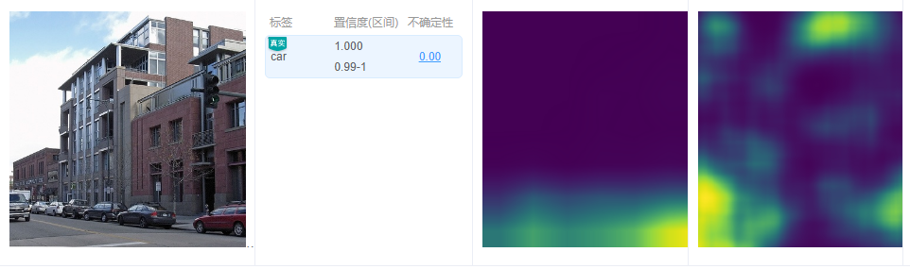
2.5 Visualization in deep learning(model explanation)
Currently, although deep learning has made a breakthrough in multiple areas, it is still a black box. It means that people cannot figure out the logic behind every prediction made by the model.
Some methods like GradCAM or RISE utilize gradients and disturbance around real sample to find pixel areas that play an important role in making final decision.
Original Image
Predicted Label
Truth

Slide 24
Contents
MindSpore and MindInsight
3.1 What's MindInsight?
3.2 Visualization Practice with MindInsight

Slide 25
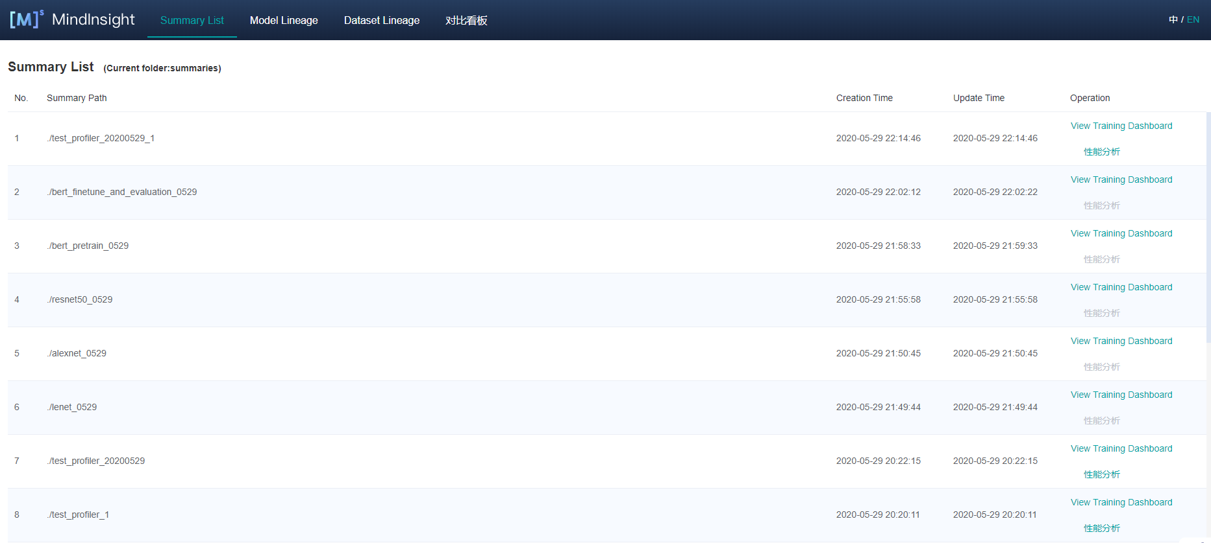
3.1 What's MindInsight?
Based on the high-performance computing framework MindSpore, MindInsight provides easy-to-use debugging and optimization capabilities in a visualization manner.
The code and visualization form may vary from version to version. The latest open source code is available at https://gitee.com/mindspore/mindinsight.

Slide 26
3.2 Visualization Practice with MindInsight (1)
Here we use hand written digits classification as an example to describe how to use MindInsight to achieve some basic visualization and facilitate our deep learning task.
Dataset: MNIST (containing 70,000 28x28 grey images in 10 classes)
Model: LeNet (a benchmark convolutional neural network in the image classification field)
Tips for preparation:
MindSpore version: 0.5.0
MindInsight version: 0.7.0
System: Ubuntu 18.04 or EulerOS
Hardware: Ascend, GPU or CPU
Anaconda
Python version: 3.7.6
Jupyter Notebook and its remote access
Start experiment Now !
The code and visualization form may vary from version to version. The latest open source code is available at https://gitee.com/mindspore/mindinsight.

Slide 27
Summary
Visualization and practice in deep learning
Objectives
Display abstract data in a visualization manner.
Provide insights for data processing and model training.
Data Visualization
Charts: box plot, scatter chart, histogram, line chart, and pie chart
Basic statistical indicators: average, variance, covariance, standard deviation, median, and mode
Non-tabular data statistics: word frequency statistics (text), pixel statistics (image), and audio statistics (audio)
Dimensionality reduction methods: PCA, LDA, t-SNE, and UMAP
Application Fields: Outlier detection, class imbalance, etc.
Visualization in Deep Learning
Model structure, Model training process, Model evaluation, Model explanation
MindInsight Practices
Using MindInsight to visualize training process and debug problems for LeNet5 with MNIST dataset.

Slide 28
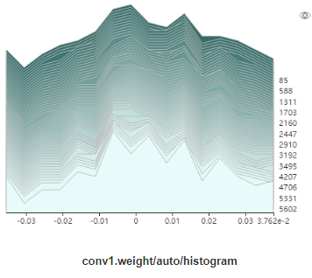
Exercises
Is average the same as median in statistics? If they are different, provide their respective expressions.
In these major dimensionality reduction methods, principal component analysis (PCA) is ___,(supervised/unsupervised) whereas linear discriminant analysis (LDA) is ___.(supervised/unsupervised)
Figure 1 is a histogram for weights of a convolutional layer. Please describe its meaning and analyze if there is a problem during the train process. If it is, please provide possible solutions.
Figure 1. Histogram for weights of a convolutional layer

Slide 29
Acronyms
LDA: Linear Discriminant Analysis
MNIST: Modified National Institute of Standards and Technology database
PCA: Principal Component Analysis
t-SNE: t-Distributed Stochastic Neighbor Embedding
UMAP: Uniform Manifold Approximation and Projection

Slide 30
Bibliography
[1] https://www.myonlinetraininghub.com/excel-tabular-data-format
[2] https://doc.arcgis.com/zh-cn/insights/create/box-plot.htm
[3] https://en.wikipedia.org/wiki/MNIST_database
[4] MING YAO. A SURVEY ON VISUALIZATION FOR EXPLAINABLE CLASSIFIERS[J]. 2017.
[5] Mooney, Chris (11 May 2016). "This scientist just changed how we think about climate change with one GIF"
[6] https://www.datacamp.com/community/tutorials/wordcloud-python
[7] http://mkweb.bcgsc.ca/color-summarizer/?
[8] https://hackernoon.com/principal-component-analysis-unsupervised-learning-model-8f18c7683262
[9] https://stats.stackexchange.com/questions/111421/reproduce-linear-discriminant-analysis-projection-plot
[10] https://apandre.wordpress.com/visible-data/outliers/
[11] https://en.wikipedia.org/wiki/Outlier
[12] https://www.datacamp.com/community/tutorials/diving-deep-imbalanced-data
[13] https://cran.r-project.org/web/packages/naniar/vignettes/naniar-visualisation.html
[14] Wongsuphasawat, Kanit, et al. "Visualizing dataflow graphs of deep learning models in tensorflow." IEEE transactions on visualization and computer graphics 24.1 (2017): 1-12.
[15] Olah, Chris, et al. "The building blocks of interpretability." Distill 3.3 (2018): e10.

